Slide 1
Internship Progress Report
Presented By: Rajkumar Mali
Enrolment Number – 20241048
Date: 18-June-2025

Slide 2
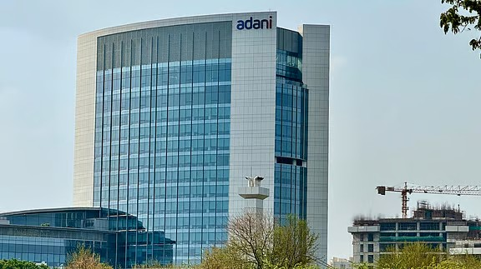

Slide 3
Department :- PMO Mentor :- Deepak Batra

Slide 4


Tools I Used
Project
Excel

Slide 5
Task Performed :-
Data Collection
Analysis of Seating Plan of @work :- Vacancy Of Desk etc.
Communication With Different Department
HR , TC , Finance , IT & Support
Creation of Effective New Seating Plan.
Task Assignment Dashboard Creation in Project App for – GCC.

Slide 6
Problem Statement of My Task
Employee Time Analysis of Atwork Building
Manul Attendance Analysis is Hard
It Time Taking Process (Like It Take Whole Day)
Not That Much Accurate Result.
Unfriendly Data Format
Also We have to Submit these Report in very short period of time.

Slide 7
Employee Time Analysis Tool
Created Using Python.
Libraries I used in These
Pandas
Streamlit
Datetime
It Gives 3 Different analysis In just 10 mins.
It gives result with zero error.

Slide 8
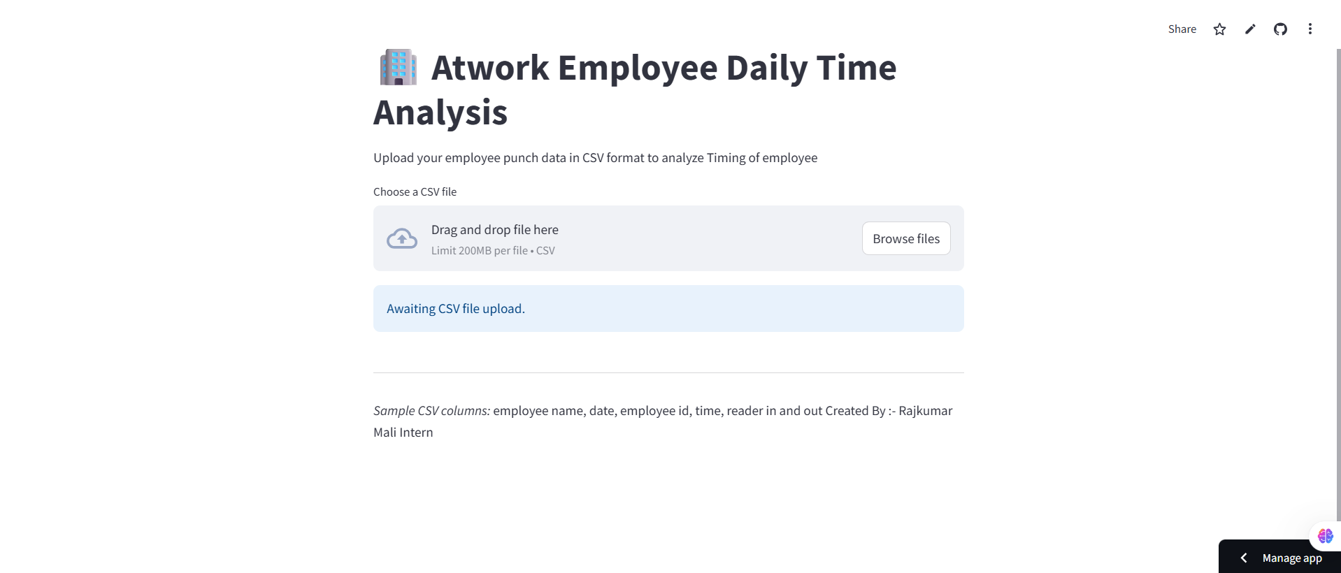
Streamlit Dashboard / Frontend for My Code

Slide 9
Output
Employee Daily Office Time
( From The difference of 1st Punch in to Last Punch in )
Employee Who Stayed Below 9 Hours a day.
Employee Who Timing Are less then 49 hours A week.
Employee Who Has One of Two (Punch in or Punch out is Missing)
These Created for The security Feedback Purpose.

Slide 10
Changes In Python Script
Only Days Visited.
Python Output
1. For Atwork Employee
2. For Visitor

Slide 11
Power Bi for (Atwork Building Analysis)
Department Wise Analysis of Employe’s Efficiency.
Total Occupancy of Building.(Atwork + Visitor)
Narrow Down Till Name of Employee.
Value Added By Me
Eliminated Manul Process.
----(Which earlier Taking Whole Day ,Now Just in 5 mins)
Improved Accuracy.
Proper Visualization of Data.

Slide 12
On Going Task
Create Python Script of ELCM Analysis.
Manipulate That And Add Seating of Each And Every Employee.

Slide 13
Thank You

